Slide 1

Creating and Deploying A NFT Contract
By
Dhru Patel

Slide 2
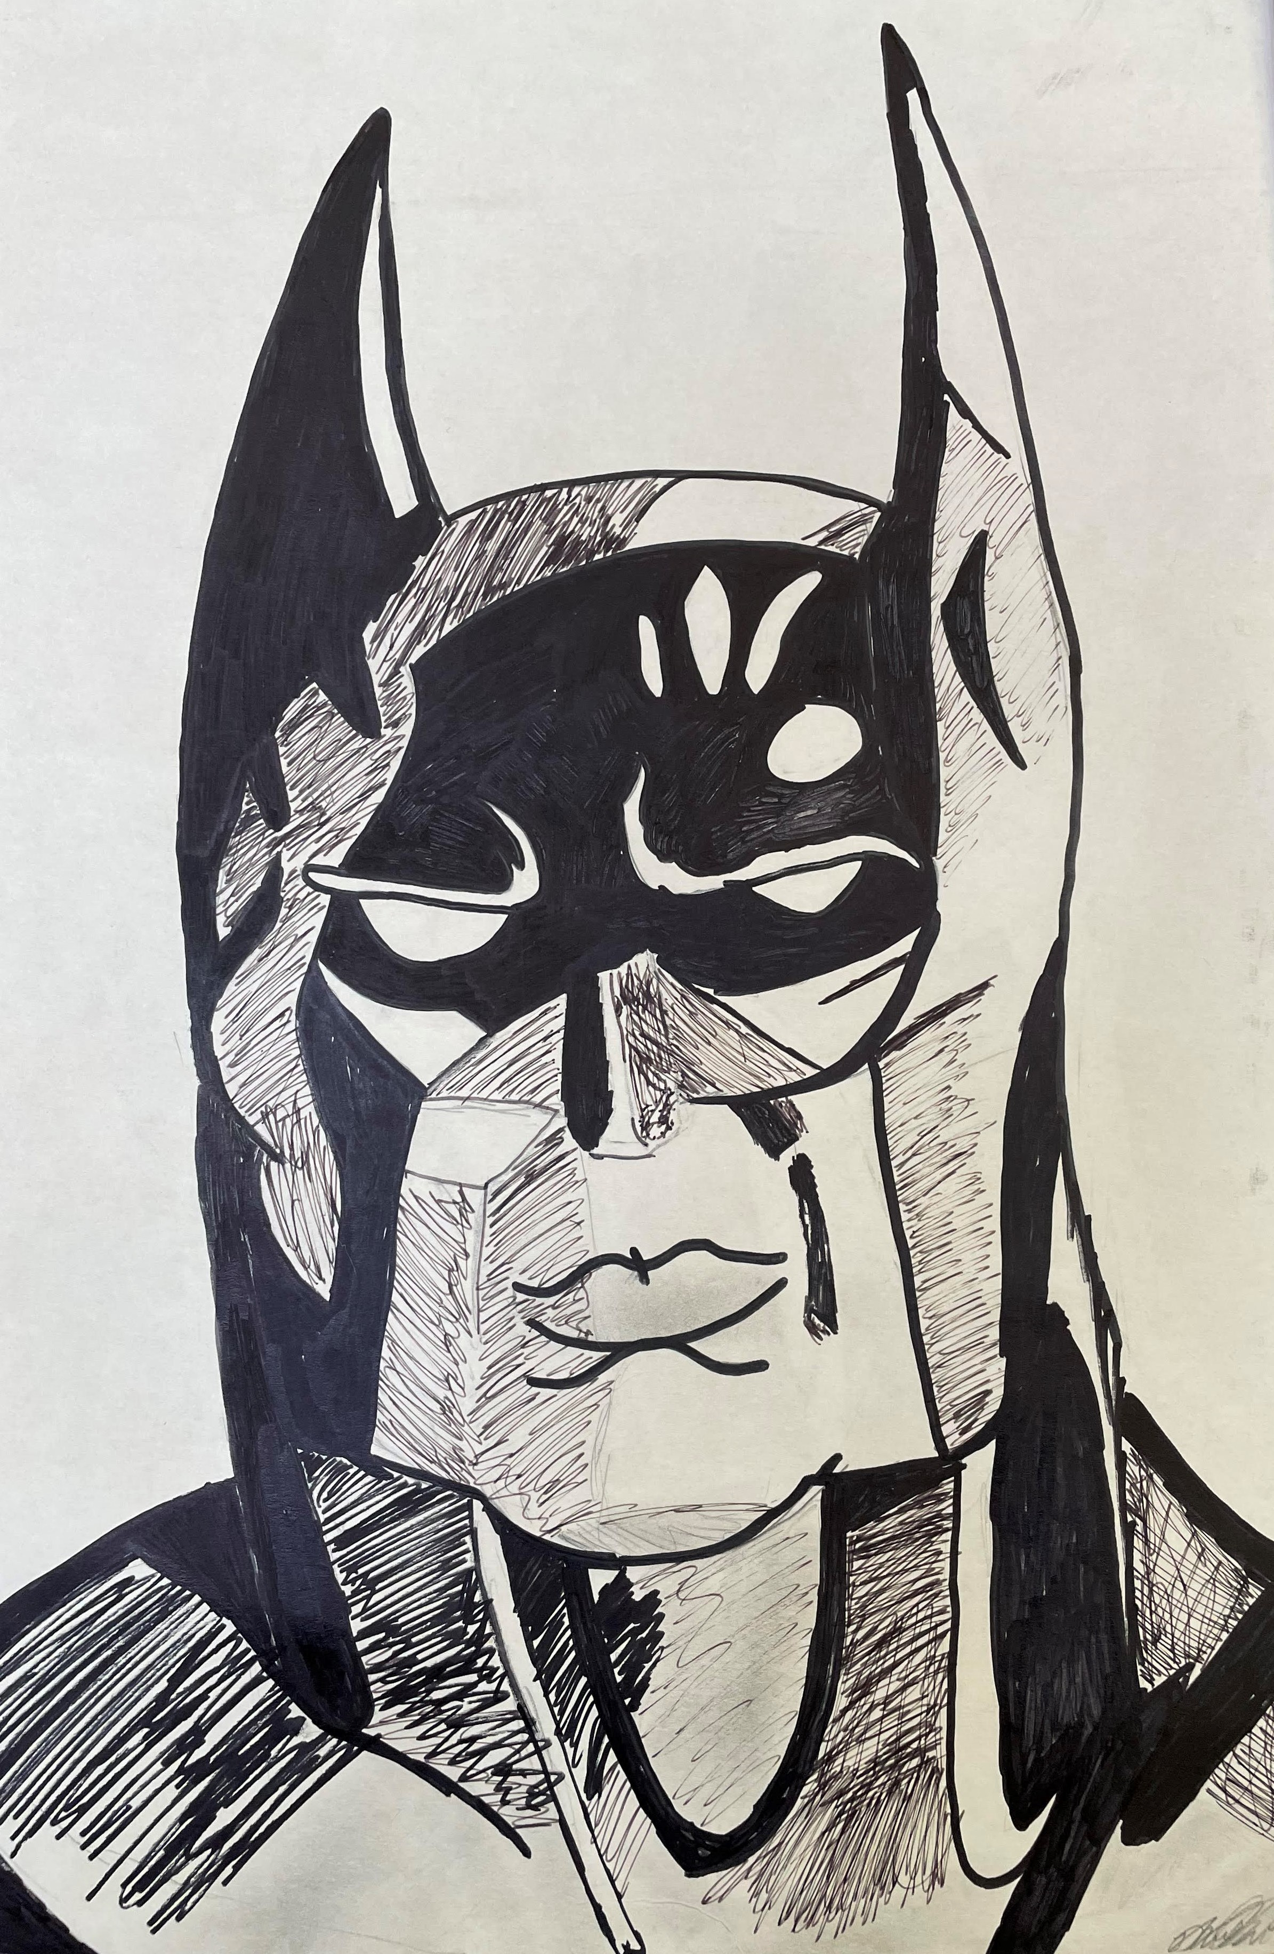
Purpose
Goal: to create and deloy a NFT in which I could potentially mint a piece of artwork I created
This would allow me to create a collection of digital art pieces of work I have done over the years
Artwork Selected

Slide 3
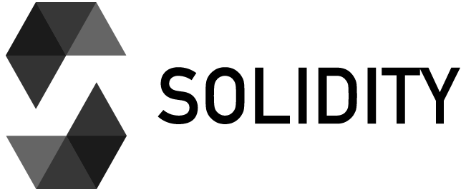

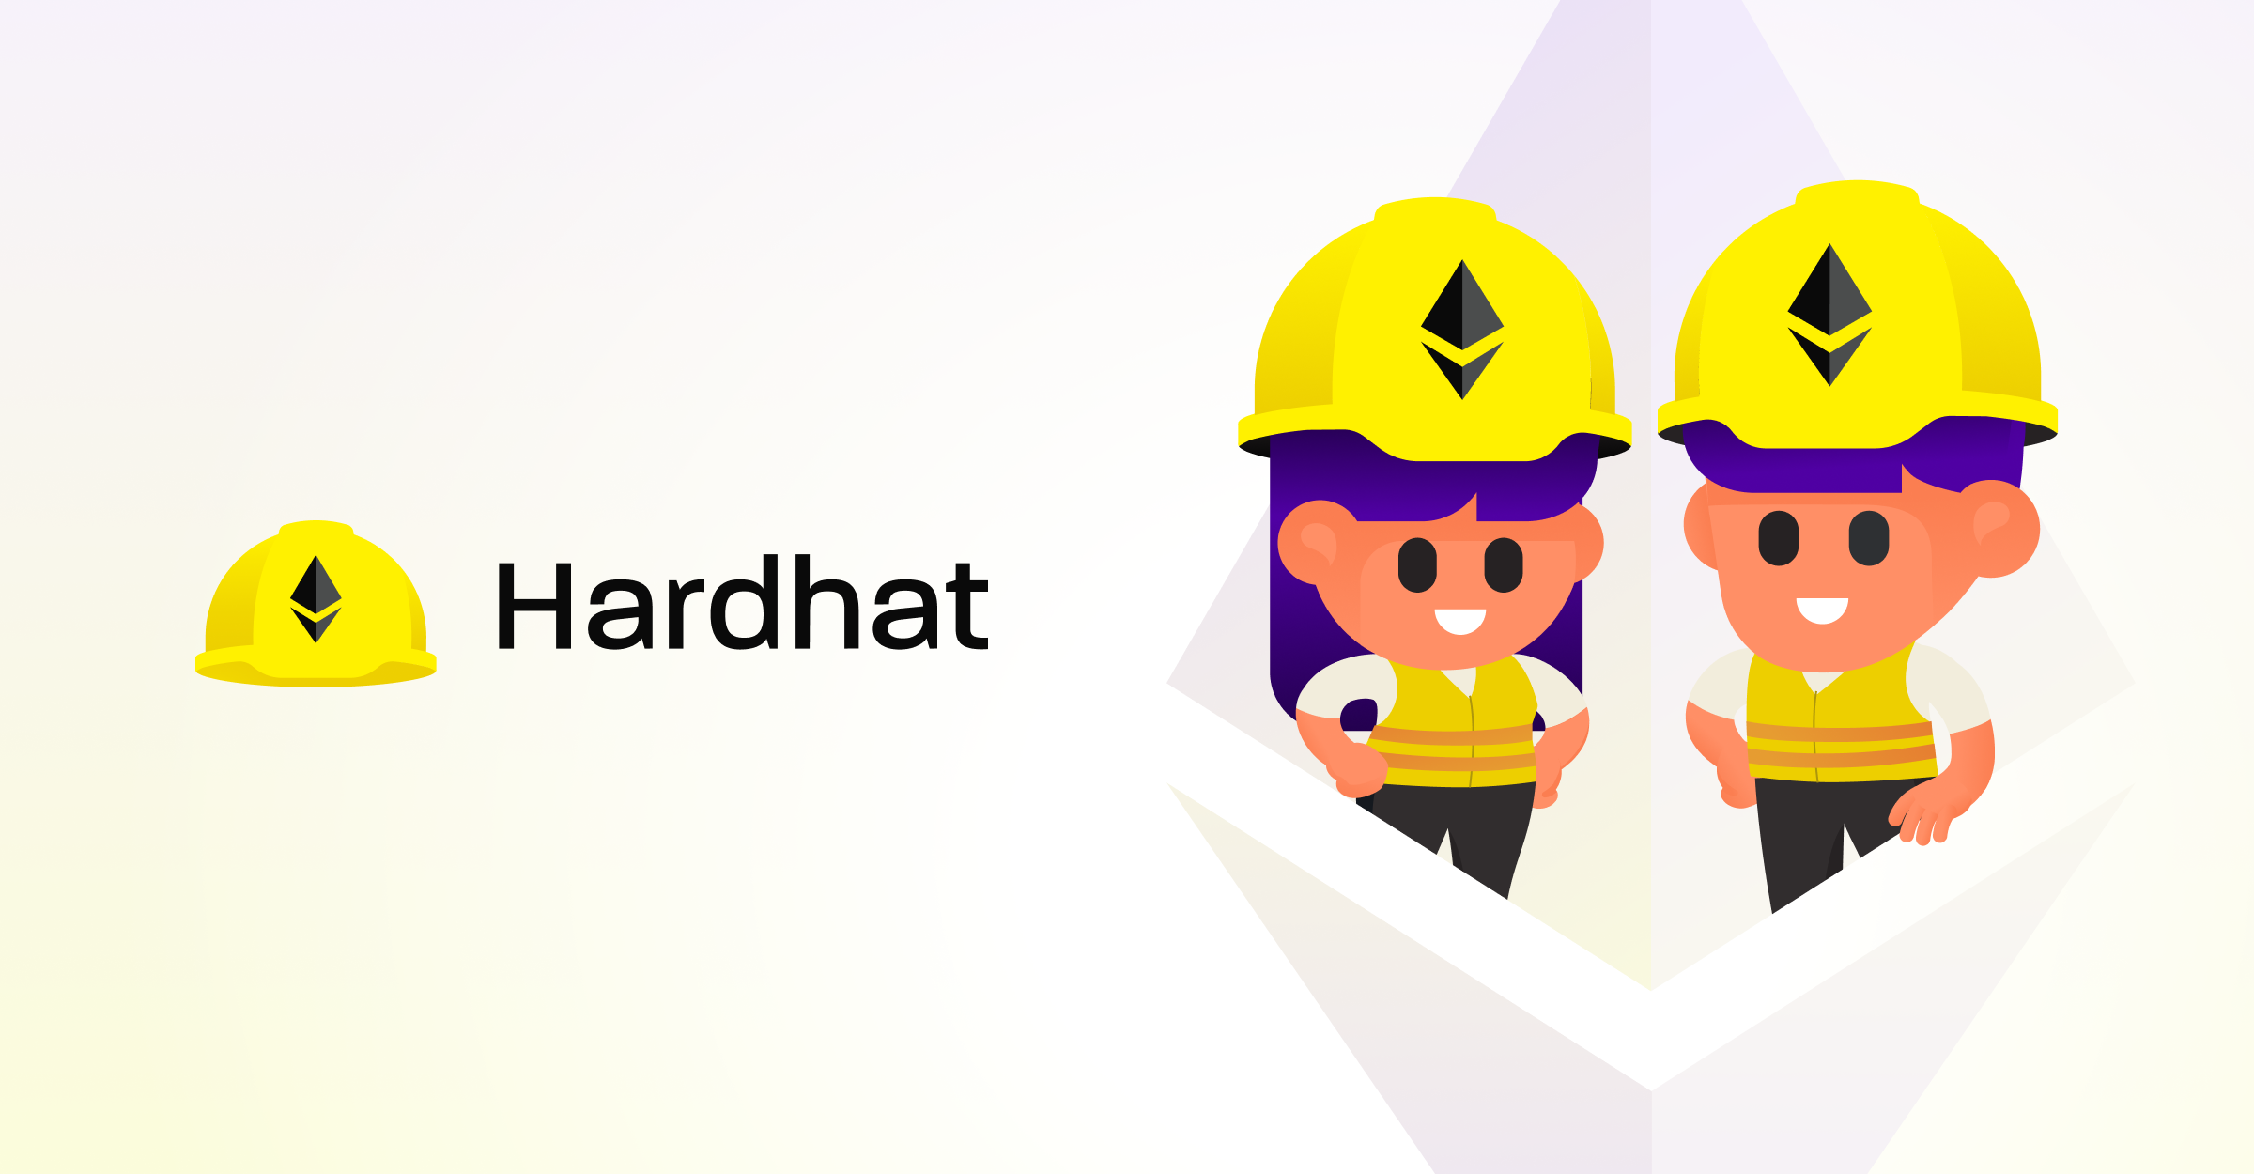
Software Used
Solidity
HardHat
Open Zeppelin
MetaMask
Remix IDE (online)

Slide 4
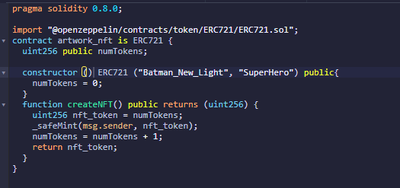
Solidity Code for NFT CONTRACT

Slide 5
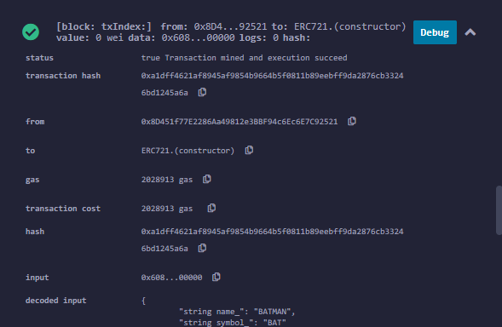
DEPLOY CONTRACT

Slide 6
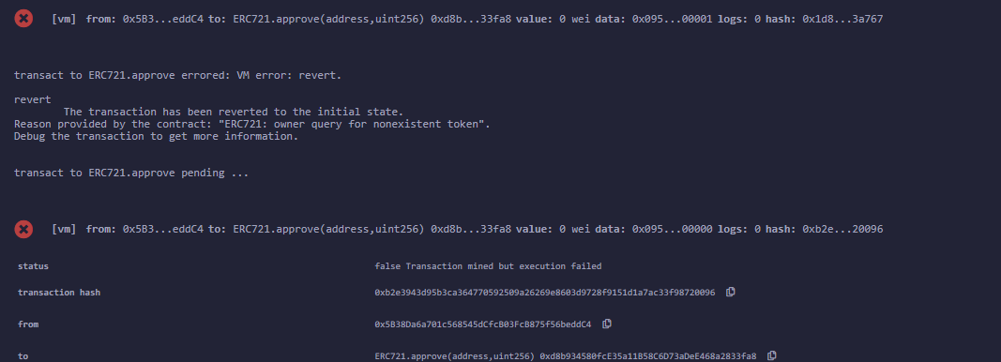
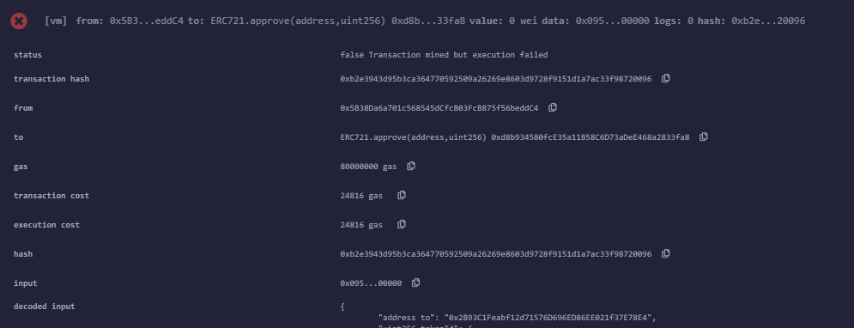
Error Messages

Slide 7
Areas of Improvement
Add functionality to create multiple editions of an NFT
Functionality that would mask an NFT from everyone except the owner
Actually minting my NFT onto a public blockchain (Ethereum, Solana)
Creating an User Interface / application, where users can go onto the application and mint their own NFT, transfer NTF’s between users

Slide 8
Future NFT Project IDEAS
Real Estate Applications
Developing an NFT to represent a title / deed of trust for individual properties
Would represent ownership of a property
Mint Mortgages that are represented in the form of an NFT
Would have attributes that would represent borrower / lender / UPB

